Slide 1
Dylan Brucki
Workplace Readiness Skills
Self Assessment

Slide 2
Personal Qualities and People Skills
Positive Work Ethic
Integrity
Teamwork
Self-Representation
Diversity Awareness
Conflict Resolution
Creativity and Resourcefulness

Slide 3
Positive Work Ethic
Pre-Assessment
Comes to work/school everyday on time?
  I am usually early for school, practice and work. If I am not early, I am still on time.
Willing to take direction?
  I take direction from teachers, and coaches. I will sometimes take direction from peers, but not as often as I should.
Motivated to accomplish the task at hand?
  I always try to accomplish the task at hand, but I can get distracted easily.

Slide 4

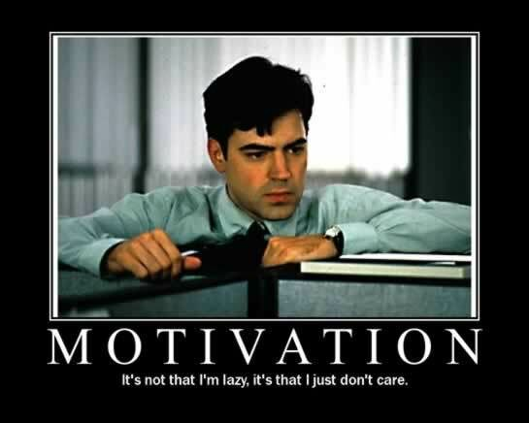
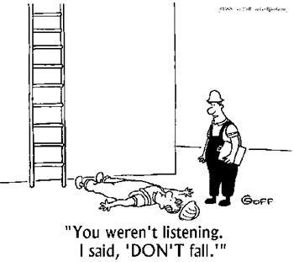
Positive Work Ethic
Post-Assessment
Better three hours too soon, than one minute too late.
  William Shakespeare
If you're going through hell, keep going.
  Winston Churchill

Slide 5
Integrity
Pre-Assessment
Abides by workplace policy and laws?
  Yes, I would never break a rule that was put before me.
Demonstrates honesty and reliability?
  As much as I can. I try to be as reliable as possible

Slide 6


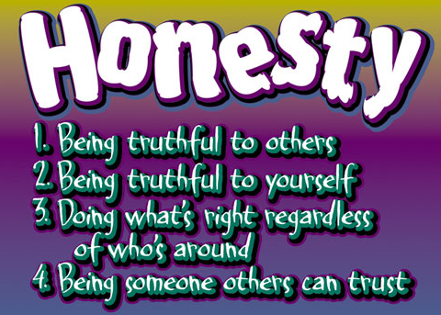
Integrity
Post-Assessment
Honesty is the first chapter in the book of wisdom.
  Thomas Jefferson
Honesty is the best policy
  Benjamin Franklin

Slide 7
Teamwork
Pre-Assessment
Contributes to the success of the team?
  I always try my best to contribute as much as I can to the team.
Assists others?
  I enjoy helping others with whatever they need.
Requests help when needed?
  I like trying to solve the problem myself, I am not the one who usually asks for help on the first couple of tries.

Slide 8


Teamwork
Post-Assessment
Magic Johnson assists video
In order to succeed, your desire for success should be greater than your fear of failure.
  Bill Cosby
Cliff Paul

Slide 9
Self-Representation
Pre-Assessment
Dresses appropriately?
  Yes. I always dress appropriate for the workplace
Uses language and manners suitable for the workplace?
  Yes, I know what is right and wrong to say in the workplace.

Slide 10
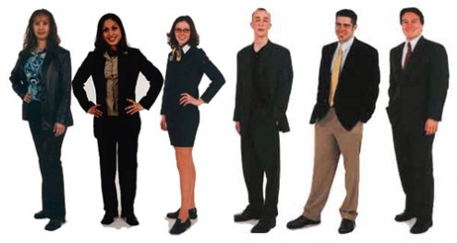

Self-Representation
Post-Assessment
If you look good, you feel good. If you feel good, you play good. If you play good, they pay good.
  Deion Sanders

Slide 11
Diversity Awareness
Pre-Assessment
Works well with all customers and coworkers?
  Even if I do not like the person, I will always try my best to set that aside and work well with everyone.

Slide 12
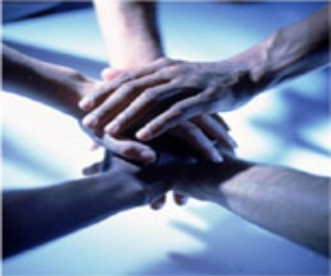

Diversity Awareness
Post-Assessment
To me, teamwork is the beauty of our sport, where you have five acting as one. You become selfless.
  Coach K
Talent wins games, but teamwork and intelligence wins championships.
  Michael Jordan

Slide 13
Conflict Resolution
Pre-Assessment
Negotiates diplomatic solutions to interpersonal and workplace issues?
  I will always try to solve conflicts in a very respectful manner.

Slide 14

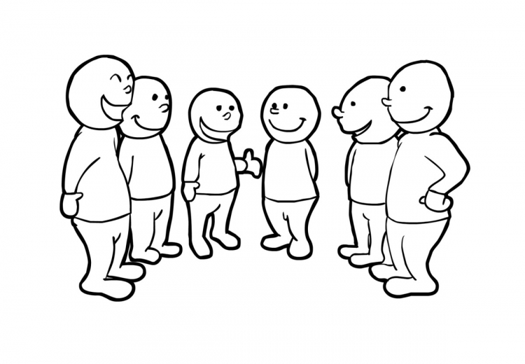
Conflict Resolution
Post-Assessment
The supreme art of war is to subdue the enemy without fighting.
  Sun Tzu
Tact is the knack of making a point without making an enemy.
  Sir Isaac Newton

Slide 15
Creativity and Resourcefulness
Pre-Assessment
Contributes new ideas?
  I like to come up with new ideas and put them in place as best I can.
Works with initiative?
  When I am given a task, I will do my best and try hard to get that done.

Slide 16

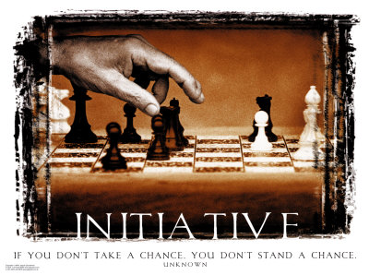
Creativity and Resourcefulness
Post-Assessment
Students must have initiative; they should not be mere imitators. They must learn to think and act for themselves - and be free.
  Cesar Chavez
When you cease to make a contribution, you begin to die.
  Eleanor Roosevelt

Slide 17
Professional Knowledge and Skills
Speaking and Listening
Reading and Writing
Critical Thinking and Problem Solving
Health and Safety
Organizations, Systems, and Climates
Lifelong Learning
Job Acquisition and Advancement
Time, Task, and Resource Management
Mathematics
Customer Service

Slide 18
Speaking and Listening
Pre-Assessment
Follows directions?
  I follow directions all the time. If I don’t get it right the first time, I go back to the directions and try again.
Communicates effectively with customers and fellow employees?
  I speak well with other employees.

Slide 19

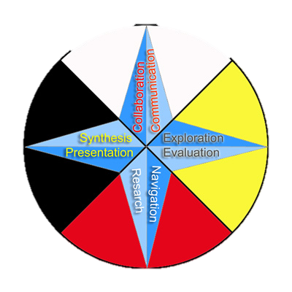
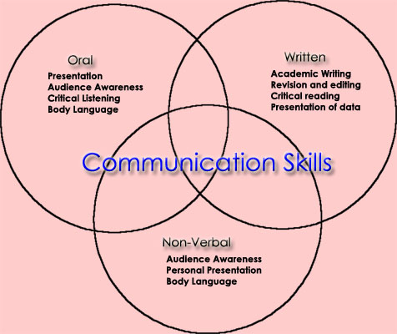
Speaking and Listening
Post-Assessment
One thing I've learned to appreciate as I've gotten a little older is direct forms of communication.
  Billy Corgan

Slide 20
Reading and Writing
Pre-Assessment
Reads and interprets workplace documents?
  I read and interpret the workplace document very good.
Writes clearly?
  I make sure to be clear in my workplace writing.

Slide 21


Reading and Writing
Post-Assessment
Either write something worth reading or do something worth writing.
  Benjamin Franklin

Slide 22
Critical Thinking and Problem Solving
Pre-Assessment
Analyzes and resolves problems?
  I am great at helping people with problems.

Slide 23

Critical Thinking and Problem Solving
Post-Assessment
We can not solve our problems with the same level of thinking that created them
  Albert Einstein
One thing is sure. We have to do something. We have to do the best we know how at the moment . . . ; If it doesn't turn out right, we can modify it as we go along.
  Franklin D Roosevelt

Slide 24
Health and Safety
Pre-Assessment
Follows safety guidelines?
  I make sure I am very safe, and follow all the guidelines.
Manages personal health?
  I manage personal health excellently.

Slide 25

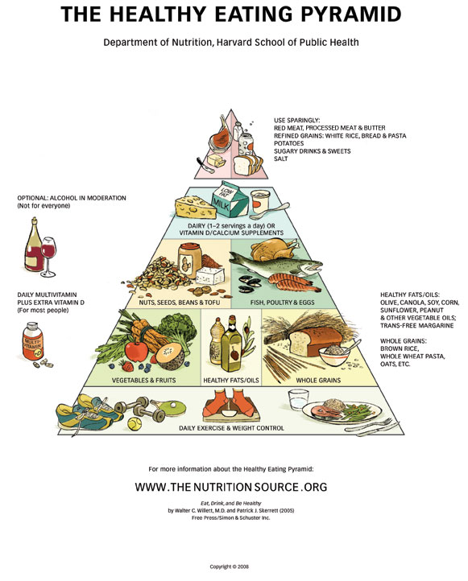
Health and Safety
Post-Assessment
Better a thousand times careful than once dead.
  Proverb
To keep the body in good health is a duty... otherwise we shall not be able to keep our mind strong and clear.
  Buddha

Slide 26
Organizations, Systems, and Climates
Pre-Assessment
Identifies “big picture” issues?
  I identify all big picture issues.
Identifies with role in fulfilling the mission of the workplace?
  I make sure the mission is complete.

Slide 27
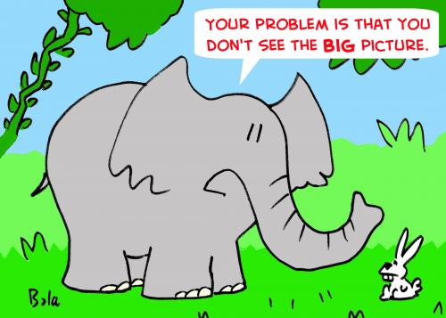

Organizations, Systems, and Climates
Post-Assessment
It's hard for young players to see the big picture. They just see three or four years down the road.
  Kareem Abdul-Jabbar
Healthy citizens are the greatest asset any country can have.
  Winston Churchill

Slide 28
Lifelong Learning
Pre-Assessment
Continually acquires new industry-related information?
  I am always trying to learn new information.
Improves professional skills?
  I am always trying to improve my skills.

Slide 29


Lifelong Learning
Post-Assessment
The control of information is something the elite always does, particularly in a despotic form of government. Information, knowledge, is power. If you can control information, you can control people.
  Tom Clancy
Improvement begins with I.
  Arnold H Glasow

Slide 30
Job Acquisition and Advancement
Pre-Assessment
Prepares to apply for a job?
  I am always prepared for job applications.
See promotion?
  I always try my best, and if a promotion comes, that just means my work has paid off.

Slide 31
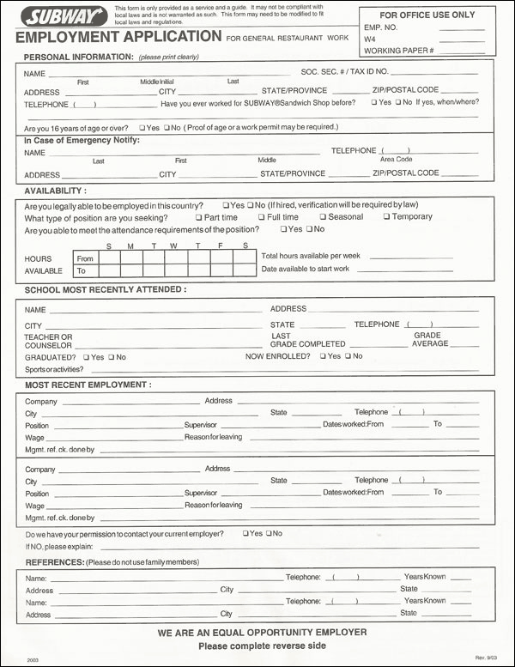

Job Acquisition and Advancement
Post-Assessment
How to apply for a job
Being ready isn't enough; you have to be prepared for a promotion or any other significant change.
  Pat Riley

Slide 32
Time, Task, and Resource Management
Pre-Assessment
Organizes and Implements a productive plan of work?
  I try to organize the most productive plan I can think of, and my team can usually help with that.

Slide 33

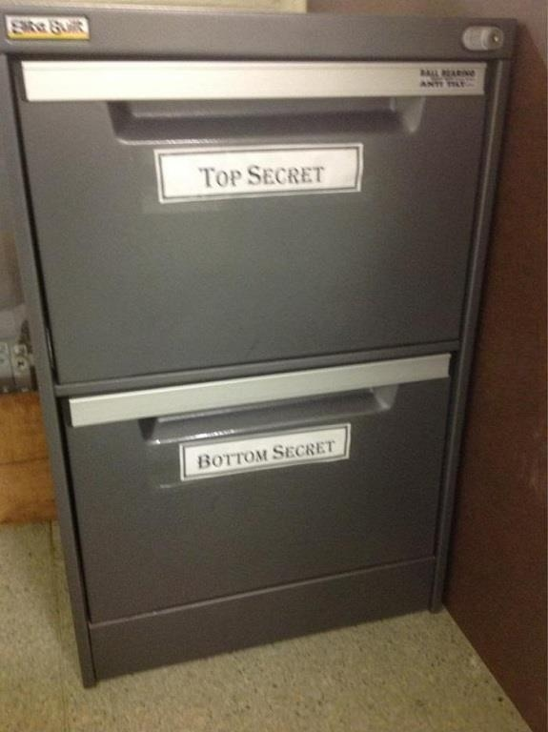
Time, Task, and Resource Management
Post-Assessment
I've been too productive for too long, and despite what anybody wants to strip away from me, I am influential. I am.
  Billy Corgan
He who every morning plans the transactions of that day and follows that plan carries a thread that will guide him through the labyrinth of the most busy life.
  Victor Hugo

Slide 34
Mathematics
Pre-Assessment
Uses mathematical reasoning to accomplish tasks?
  I love math, and always use it when I can.

Slide 35

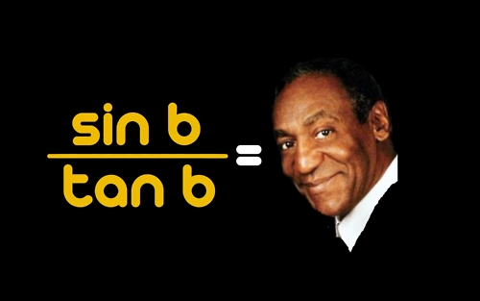
Mathematics
Post-Assessment
Pure mathematics is, in its way, the poetry of logical ideas.
  Albert Einstein
Number rules the universe.
  Pythagoras

Slide 36
Customer Service
Pre-Assessment
Identifies and addresses the needs of all customers?
  All of the customers will be pleased, but not always on the same day.
Provides helpful, courteous, and knowledgeable service?
  I strive to know everything that a customer will ask.

Slide 37
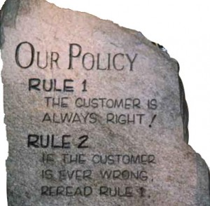
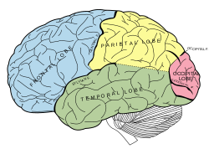
Customer Service
Post-Assessment
It is not the employer who pays the wages. Employers only handle the money. It is the customer who pays the wages.
  Henry Ford
Service to others is the rent you pay for your room here on earth.
  Muhammad Ali
Peggy
Also Peggy
Peggy and Lou Holtz

Slide 38
Technology Knowledge and Skills
Job-Specific Technologies
Information Technology
Internet Use and Security
Telecommunications

Slide 39
Job-Specific Technologies
Pre-Assessment
Selects and safely uses technological resources to accomplish work?
  I usually use technology to help accomplish the task at hand.
Is productive?
  I am very productive, and will finish my tasks in a timely manner.

Slide 40
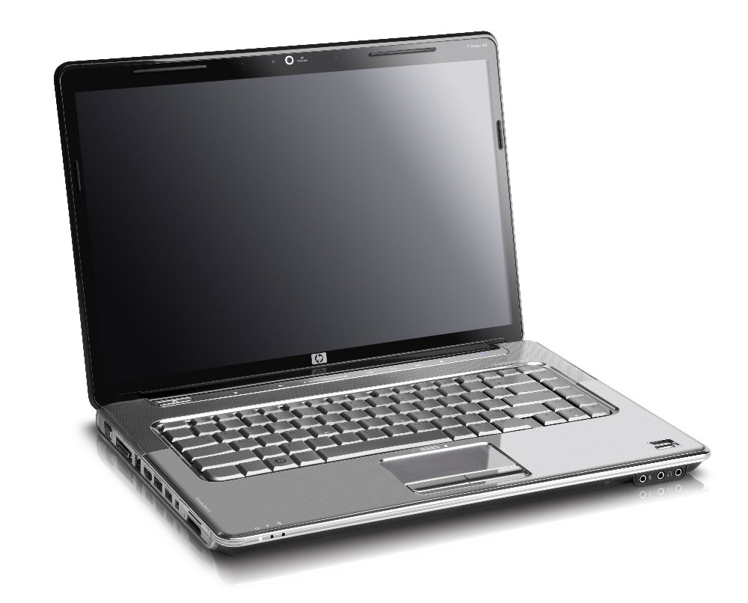
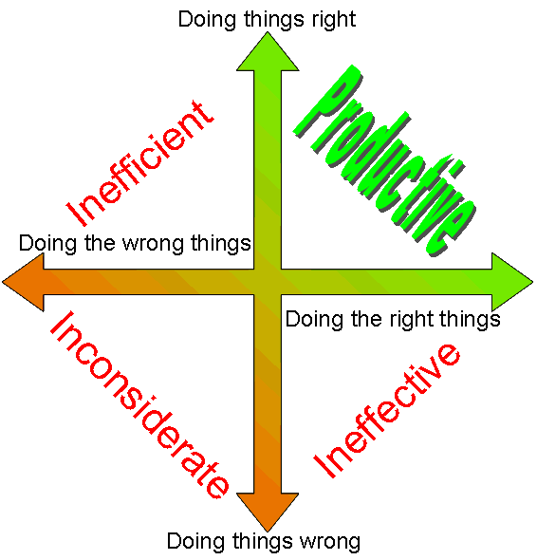
Job-Specific Technologies
Post-Assessment
Dictionary is the only place that success comes before work. Hard work is the price we must pay for success. I think you can accomplish anything if you're willing to pay the price.
  Vince Lombardi
Amateurs sit and wait for inspiration, the rest of us just get up and go to work.
  Stephen King
If you spend too much time thinking about a thing, you'll never get it done.
  Bruce Lee

Slide 41
Information Technology
Pre-Assessment
Uses computers, file management techniques, and software/programs effectively?
  I know how to use all of these things, and use them effectively to accomplish tasks.

Slide 42
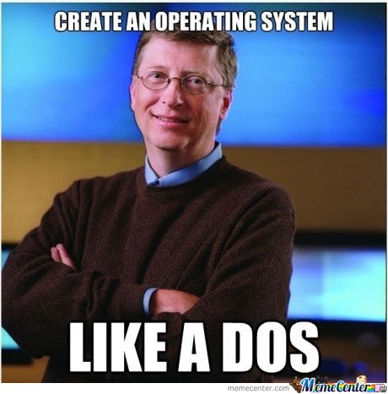
Information Technology
Post-Assessment
I was lucky to be involved and get to contribute to something that was important, which is empowering people with software.
  Bill Gates

Slide 43
Internet Use and Security
Pre-Assessment
Uses the Internet appropriately for work/school?
  The Internet is used always for appropriate resources in the school or workplace.

Slide 44

Internet Use and Security
Post-Assessment
The internet has been a boon and a curse for teenagers.
  JK Rowling
Your basic person wants to talk about material culture, internet culture. I think about God, cats, nature.
  Billy Corgan
The Internet is becoming the town square for the global village of tomorrow.
  Bill Gates

Slide 45
Telecommunications
Pre-Assessment
Selects and uses appropriate devices, services, and applications?
  I use the appropriate applications for whatever I need to do.

Slide 46

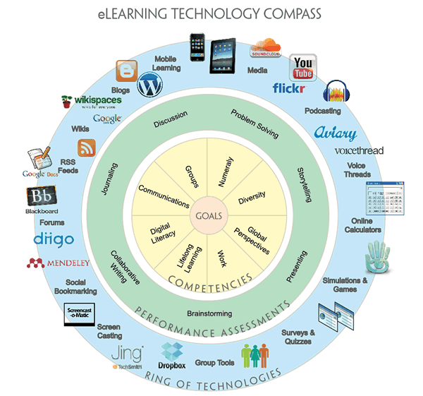
Telecommunications
Post-Assessment
Men of the woods and lumberjacks,
They judged me by their appropriate tool.
Except as a fellow handled an ax,
They had no way of knowing a fool.
  Robert Frost
Can you hear me now?

Slide 47

Hopefully with the use of these tips, you too can be Workplace Ready!

